Slide 1

GAME ANALYSIS USING SQL
PROJECT NAME: DECODE GAMING BEHAVIOR
PRESENTED BY: NIMRA SULTAN
001

Slide 2
Introduction
Analyzing Gaming Behavior: A Data-driven Approach
Welcome to the presentation on analyzing gaming behavior through data insights.
We'll delve into the details of player engagement, performance, and trends within the gaming environment.
Let's explore how SQL queries unveil hidden patterns and unlock valuable insights from the dataset.

Slide 3
Dataset Overview
Our dataset consists of two primary tables:
Player Details and Level Details.
Player Details Table:
Level Details Table:
• `P_ID`: Player ID
• `PName`: Player Name
• `L1_status`: Level 1 Status
• `L2_status`: Level 2 Status
• `L1_code`: Systemgenerated Level 1 Code
• `L2_code`: Systemgenerated Level 2 Code
`P_ID`: Player ID
• `Dev_ID`: Device ID
• `start_time`: Start Time
• `stages_crossed`: Stages Crossed
• `level`: Game Level
• `difficulty`: Difficulty Level
• `kill_count`: Kill Count
• `headshots_count`: Headshots Count
• `score`: Player Score
• `lives_earned`: Extra Lives Earned

Slide 4
Problem Statement Game Analysis dataset
Players play a game divided into 3-levels (L0,L1 and L2)
Each level has 3 difficulty levels (Low,Medium,High)
At each level,players have to kill the opponents using guns/physical fight
Each level has multiple stages at each difficulty level.
A player can only play L1 using its system generated L1_code.
Only players who have played Level1 can possibly play Level2 using its system generated L2_code.
By default a player can play L0.
Each player can login to the game using a Dev_ID.
Players can earn extra lives at each stage in a level.

Slide 5
Project Objectives
Navigating Key Challenges with SQL
Our mission is to address fifteen specific questions through SQL queries.
Each question is tailored to extract insights, solve challenges, and enhance our understanding of gaming behavior.
By leveraging SQL, we aim to unravel patterns, trends, and correlations hidden within the dataset.

Slide 6
Unveiling Insights through SQL Queries

Slide 7
SQL Queries & Insights
Each SQL query is meticulously designed to tackle a specific aspect of gaming analysis.
From identifying player demographics to evaluating performance metrics, we leave no stone unturned.
Let's dive into the results and uncover the fascinating insights derived from our SQL-driven approach.

Slide 8
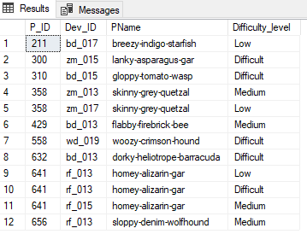
Q1) Extract P_ID,Dev_ID,PName and Difficulty_level of all players at level 0
select pd.P_ID , ld.Dev_ID , pd.PName , ld.Difficulty as Difficulty_level from player_details pd
join level_details2 ld on pd.P_ID = ld.P_ID
where ld.Level = 0;

Slide 9
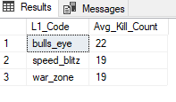
Q2) Find Level1_code wise Avg_Kill_Count where lives_earned is 2 and atleast 3 stages are crossed
select pd.L1_Code,avg(ld.Kill_Count) as Avg_Kill_Count from player_details pd
join level_details2 ld on pd.P_ID = ld.P_ID
where ld.Lives_Earned = 2 and ld.Stages_crossed >= 3
group by pd.L1_Code

Slide 10
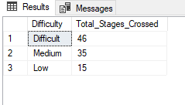
Q3) Find the total number of stages crossed at each diffuculty level where for Level2 with players use zm_series devices. Arrange the result in decsreasing order of total number of stages crossed.
select ld.Difficulty , sum(ld.stages_crossed) as Total_Stages_Crossed from level_details2 ld
where ld.Level = 2 and ld.Dev_ID LIKE 'zm_%'
group by ld.Difficulty
order by Total_Stages_Crossed desc

Slide 11
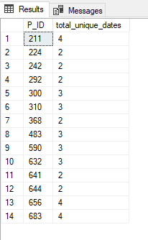
Q4) Extract P_ID and the total number of unique dates for those players who have played games on multiple days.
Select P_ID, COUNT(DISTINCT CONVERT(DATE,ld.TimeStamp )) as total_unique_dates
from level_details2 ld
group by P_ID
having count(DISTINCT CONVERT(DATE, ld.TimeStamp)) > 1;

Slide 12
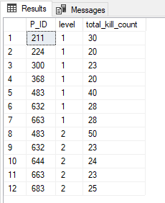
Q5) Find P_ID and level wise sum of kill_counts where kill_count is greater than avg kill count for the Medium difficulty.
WITH MediumAvgKill AS (
SELECT AVG(kill_count) AS avg_kill_count
FROM level_details2
WHERE difficulty = 'Medium'
)
SELECT pd.P_ID, ld.level, SUM(ld.kill_count) AS total_kill_count
FROM player_details pd
JOIN level_details2 ld ON pd.P_ID = ld.P_ID
JOIN MediumAvgKill as avg_kill_table ON ld.difficulty = 'Medium' AND ld.kill_count > avg_kill_table.avg_kill_count
GROUP BY pd.P_ID, ld.level;

Slide 13
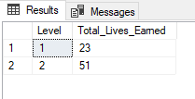
Q6) Find Level and its corresponding Level code wise sum of lives earned excluding level 0. Arrange in asecending order of level.
select ld.Level, sum(ld.Lives_Earned) as Total_Lives_Earned from level_details2 ld
where ld.Level <> 0
group by ld.Level
order by ld.Level asc

Slide 14
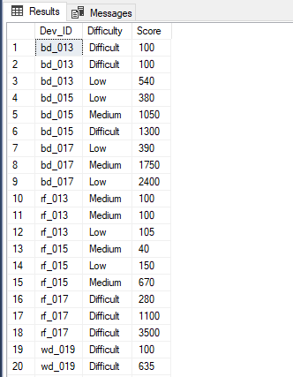
Q7) Find Top 3 score based on each dev_id and Rank them in increasing orderusing Row_Number. Display difficulty as well.
WITH RankedScores AS (
SELECT
Dev_ID,
Difficulty,
Score,
ROW_NUMBER() OVER (PARTITION BY Dev_ID ORDER BY Score ASC) AS ScoreRank
FROM level_details2 )
SELECT
Dev_ID,
Difficulty,
Score
FROM RankedScores
WHERE ScoreRank <= 3;

Slide 15
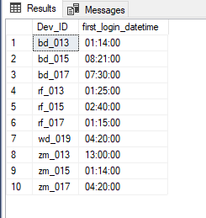
Q8) Find first_login datetime for each device id
SELECT
Dev_ID,
MIN(CONVERT(varchar, timestamp, 108)) AS first_login_datetime
FROM level_details2
GROUP BY Dev_ID;

Slide 16
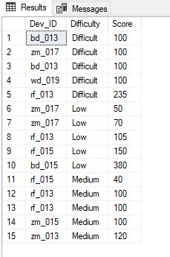
Q9) Find Top 5 score based on each difficulty level and Rank them in increasing order using Rank. Display dev_id as well.
WITH RankedScores AS (
SELECT
Dev_ID,Difficulty, Score,
RANK() OVER (PARTITION BY Difficulty ORDER BY Score ASC) AS score_rank
FROM
level_details2)
SELECT
Dev_ID, Difficulty,Score
FROM
RankedScores
WHERE
score_rank <= 5;

Slide 17
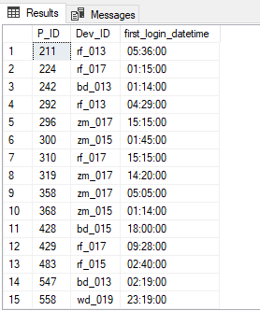
Q10) Find the device ID that is first logged in(based on start_datetime) for each player(p_id). Output should contain player id, device id and first login datetime.
WITH FirstLogin AS (
SELECT
P_ID,Dev_ID,
CONVERT(varchar, timestamp, 108) as Start_Time,
ROW_NUMBER() OVER (PARTITION BY P_ID ORDER BY CONVERT(varchar, timestamp, 108)) AS login_rank
FROM level_details2 )
SELECT
P_ID, Dev_ID, Start_Time AS first_login_datetime
FROM FirstLogin
WHERE
login_rank = 1;

Slide 18
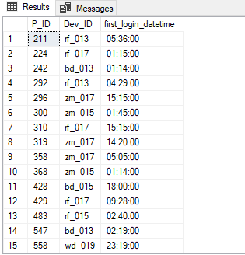
Q11) For each player and date, how many kill_count played so far by the player. That is, the total number of games played -- by the player until that date. a) window function b) without window function
a) window function
SELECT
P_ID,
CONVERT(date, TimeStamp) AS play_date,
SUM(kill_count) OVER (PARTITION BY P_ID ORDER BY CONVERT(date, TimeStamp)) AS total_kill_count
FROM
level_details2;

Slide 19
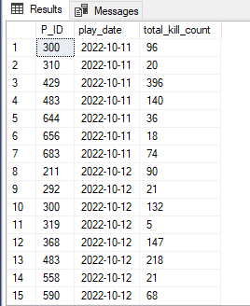
b) without window function
SELECT
ld1.P_ID,
CONVERT(date, ld1.TimeStamp) AS play_date,
SUM(ld2.kill_count) AS total_kill_count
FROM
level_details2 ld1
JOIN
level_details2 ld2 ON ld1.P_ID = ld2.P_ID
AND CONVERT(date, ld1.TimeStamp) >= CONVERT(date, ld2.TimeStamp)
GROUP BY
ld1.P_ID, CONVERT(date, ld1.TimeStamp);

Slide 20
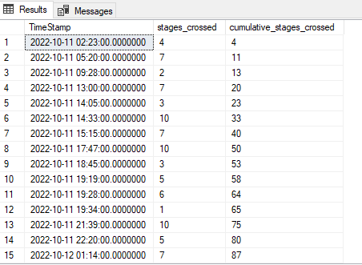
Q12) Find the cumulative sum of stages crossed over a start_datetime
SELECT
TimeStamp,
stages_crossed,
SUM(stages_crossed) OVER (ORDER BY Timestamp) AS cumulative_stages_crossed
FROM
level_details2;

Slide 21
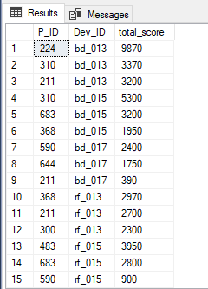
Q13) Extract top 3 highest sum of score for each device id and the corresponding player_id
WITH RankedScores AS (
SELECT
P_ID, Dev_ID, SUM(score) AS total_score,
ROW_NUMBER()
OVER (PARTITION BY Dev_ID ORDER BY SUM(score) DESC) AS score_rank
FROM
level_details2
GROUP BY
P_ID, Dev_ID )
SELECT
P_ID, Dev_ID, total_score
FROM
RankedScores
WHERE
score_rank <= 3;

Slide 22
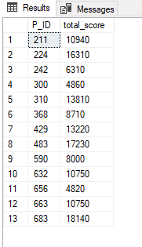
Q14) Find players who scored more than 50% of the avg score scored by sum of scores for each player_id
SELECT
ld.P_ID,
SUM(ld.score) AS total_score
FROM
level_details2 ld
GROUP BY
ld.P_ID
HAVING
SUM(ld.score) > 0.5 * (SELECT AVG(total_score)
FROM (SELECT P_ID, SUM(score)
AS total_score FROM level_details2 GROUP BY P_ID) AS avg_scores);

Slide 23
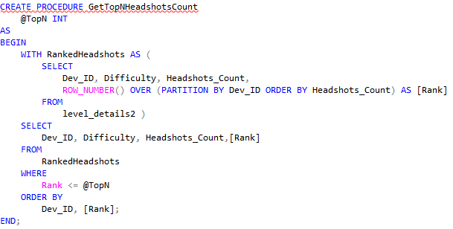
Q15) Create a stored procedure to find top n headshots_count based on each dev_id and Rank them in increasing order using Row_Number. Display difficulty as well.

Slide 24
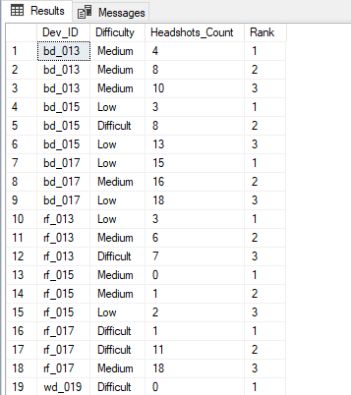
output:

Slide 25
Thanks!

